Slide 1
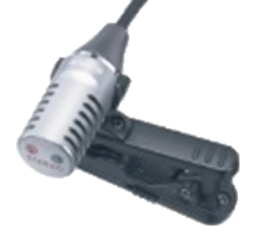
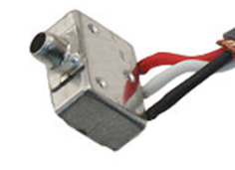
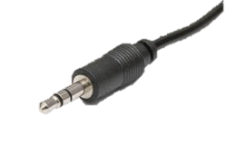
Desired Functionality of Mic Jack
Stereo Lapel Mic
Stereo Line-Level
3-Port Mic (Mono)
Ground
Ground
Ground
Mic Audio Right (w/V+ Bias)
Right Audio
Mic Audio Out
Mic Audio Left (w/V+ Bias)
Left Audio
V+ Bias

Slide 2
Actual Functionality of Mic Jack Tympan Rev A and Rev B
Stereo Lapel Mic
Mono Line-Level
3-Port Mic (Mono)
Ground
Ground
Ground
Mic Audio Right (w/V+ Bias)
Right Audio
Mic Audio Out
Mic Audio Left (w/V+ Bias)
Left Audio
V+ Bias

Slide 3
Expected Functionality After Tympan Re-Design to Rev C
Mono Lapel Mic
Stereo Line-Level
3-Port Mic (Mono)
Ground
Ground
Ground
(Unused)
Right Audio
Mic Audio Out
Mic Audio Left (w/V+ Bias)
Left Audio
V+ Bias

Slide 4
Wiring for Endevco 3-Wire Mic
3-Port Mic (Mono)
Red: V+ Bias (Tip)
White: Output (Ring)
Black: Ground (Sleeve)
Ground
Mic Audio Out
V+ Bias
Element: EK-23024
Element w/Cable: Digikey EK-23024-P07

